Slide 1
Neural Network & Python Implementation
Mar 24, 2019
June Li

Slide 2
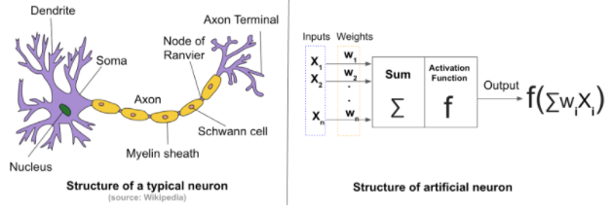
What is Neural Network?
“Neural networks are a set of algorithms, modeled loosely after the human brain, that are designed to recognize patterns. They interpret sensory data through a kind of machine perception, labeling or clustering raw input. The patterns they recognize are numerical, contained in vectors, into which all real-world data, be it images, sound, text or time series, must be translated.”
https://skymind.ai/wiki/neural-network#define

Slide 3
Application of Neural Network
Classification
Detect faces, identify people in images, recognize facial expressions (angry, joyful)
Identify objects in images (stop signs, pedestrians, lane markers…)
Recognize gestures in video
Detect voices, identify speakers, transcribe speech to text, recognize sentiment in voices
Classify text as spam (in emails), or fraudulent (in insurance claims); recognize sentiment in text (customer feedback)
Clustering
Search: Comparing documents, images or sounds to surface similar items.
Anomaly detection: The flipside of detecting similarities is detecting anomalies, or unusual behavior.
Predictive Analytics: Regressions
Employee turnover (tenure), customer lifetime value

Slide 4
Foundation of NN: Logistic Regression

Slide 5
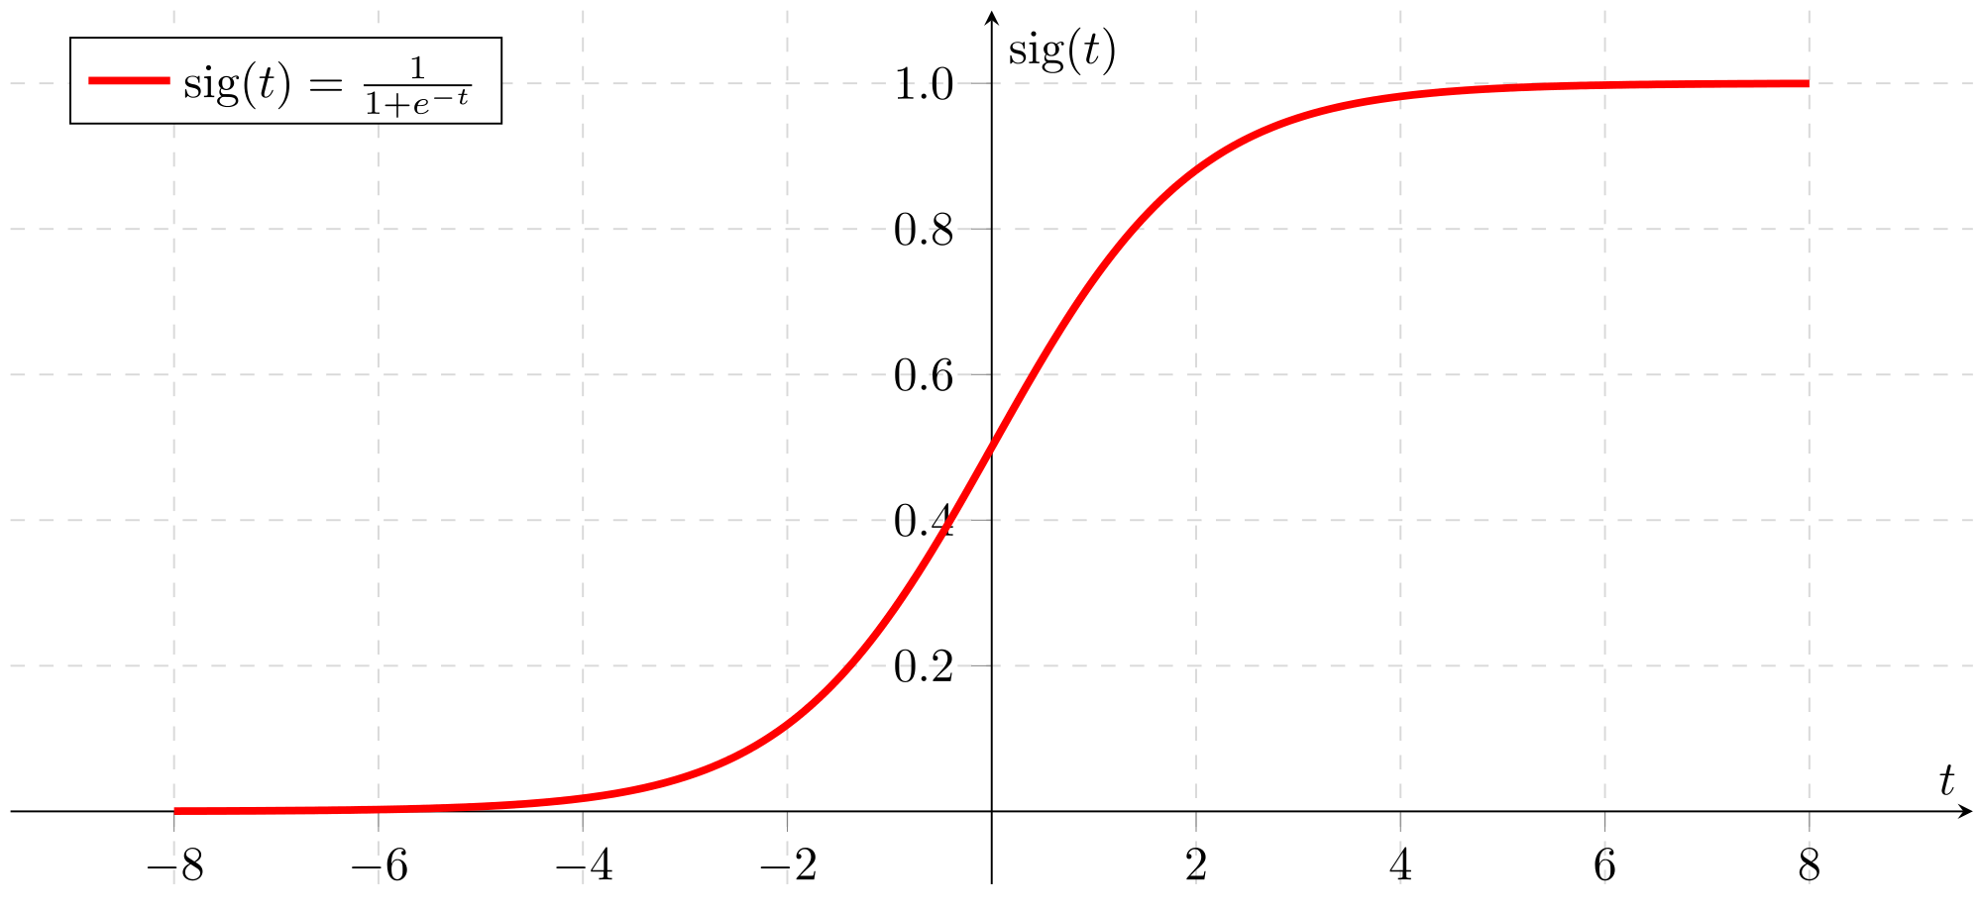
Logistic Regression
Logistic regression is a type of model that uses logistic function to model a binary dependent target (0/1).
It find the values of a functions parameters through forward and backward propagation to minimize a cost function. This process is called gradient descent.
The final output of model goes through sigmoid function transformation and becomes probabilities ranging from 0 to 1.

Slide 6
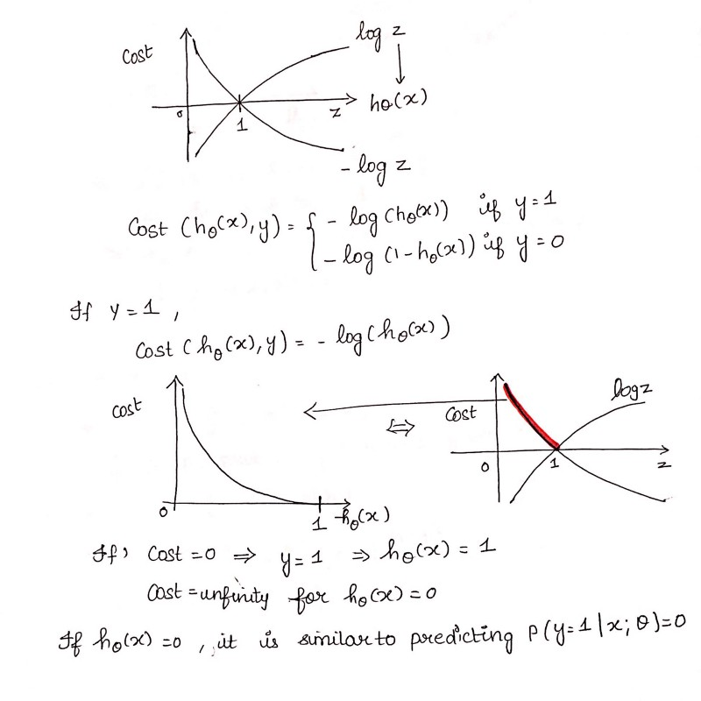
Loss Function
A loss function is a measure of how good a prediction model does in terms of being able to predict the expected outcome.

Slide 7
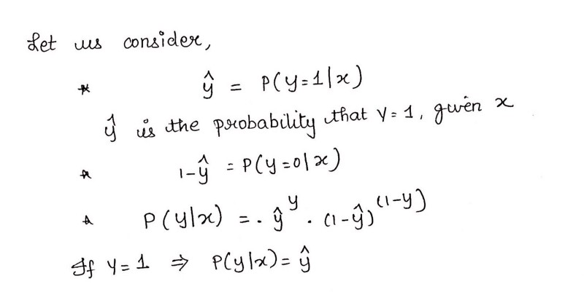
Loss Function Intuition
A loss function is a measure of how good a prediction model does in terms of being able to predict the expected outcome.

Slide 8
Neural Network Building Blocks

Slide 9
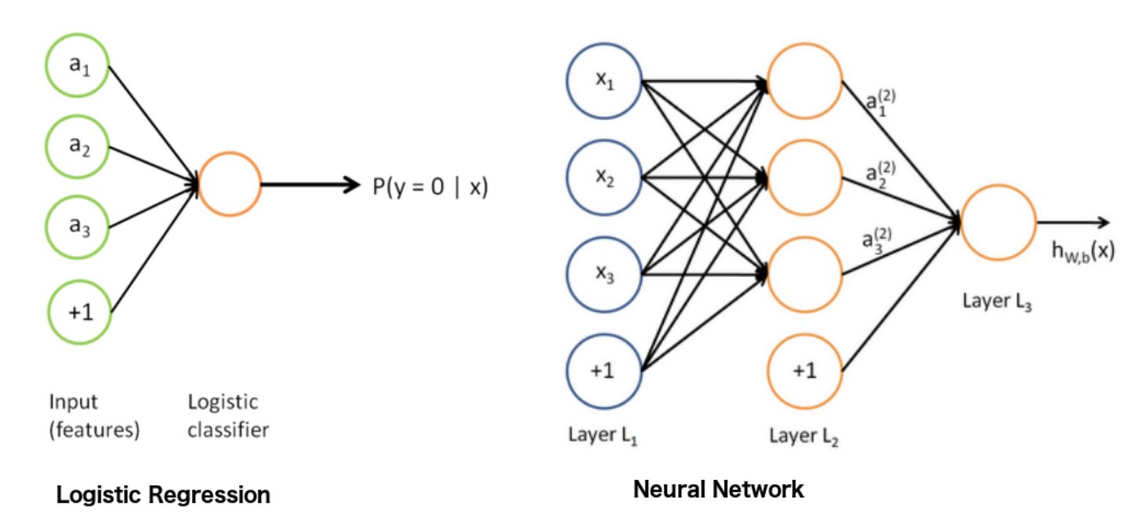
Logistic Regression & Neural Network
Basically, we can think of logistic regression as a one layer neural network.
A deep NN is a combination of multiple perceptrons (lr) and to be performed multiple times by using the output from the previous layer as the input.

Slide 10
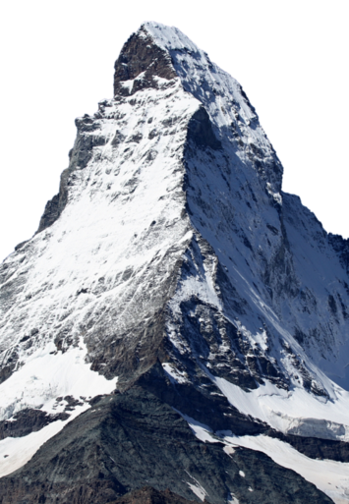
What is Gradient Descent
What is a Gradient?
“A gradient measures how much the output of a function changes if you change the inputs a little bit.” — Lex Fridman (MIT)
What is Gradient Descent?
“ An iterative process that find the values of a functions parameters through forward and backward propagation to minimize a cost function as far as possible. “ – me ☺
Gradient descent is utilized to minimize the cost function in both logistic regression and NN.
How big the steps are that Gradient Descent takes into the direction of the local minimum are determined by the learning rate. It determines how fast or slow we will move towards the optimal weights.

Slide 11
Types of Gradient Descent
Batch Gradient Descent: calculates the error for each example within the training dataset, but only after all training examples have been evaluated, the model gets updated
Stochastic Gradient Descent: In contrary, does this for each training example within the dataset
Mini Batch Gradient Descent: Mini-batch Gradient Descent is the go-to method since it’s a combination of the concepts of SGD and Batch Gradient Descent. It simply splits the training dataset into small batches and performs an update for each of these batches. Therefore it creates a balance between the robustness of stochastic gradient descent and the efficiency of batch gradient descent.

Slide 12
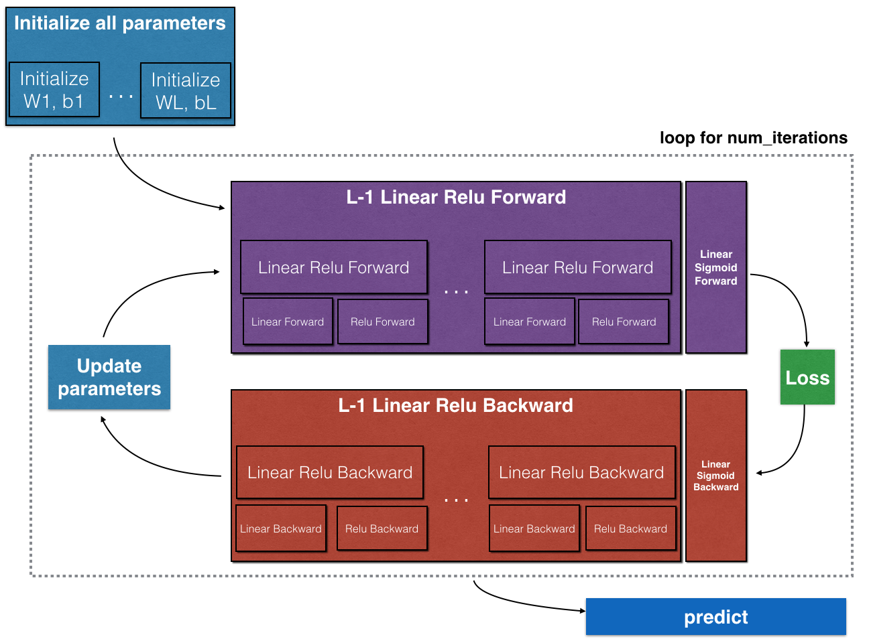
Building Blocks of Neural Net

